Slide 1
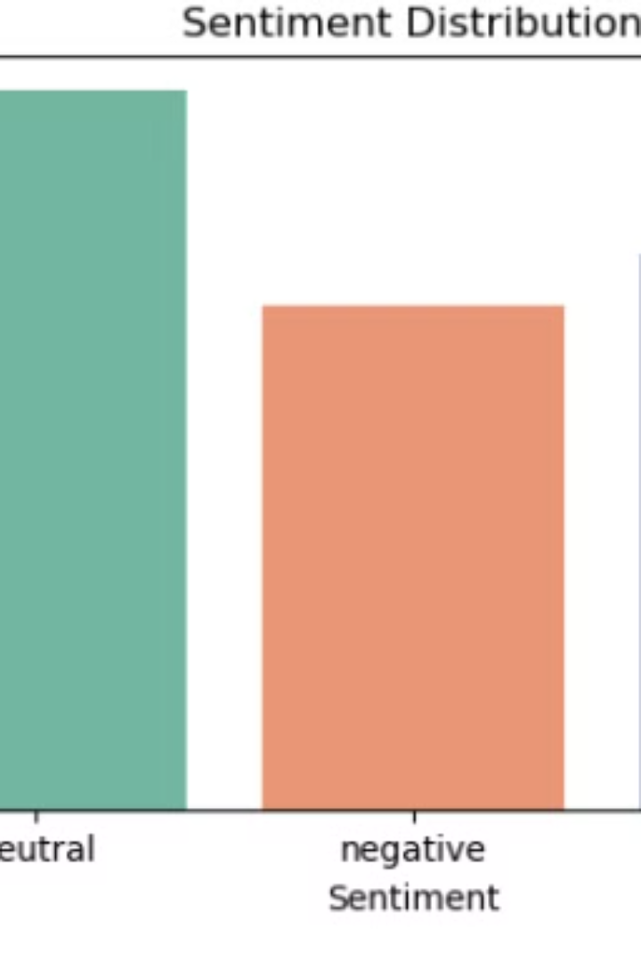

Sentiment Analysis of Tweets
This presentation outlines the process of sentiment analysis on a dataset of 27,481 tweets, each containing text, selected text, and a sentiment label.
by Radhika Ambulkar

Slide 2
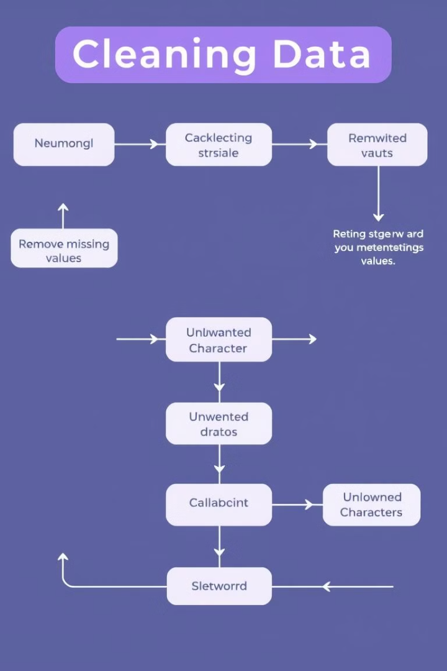
Data Cleaning
1
Missing Values
The dataset contains missing values in the text and selected_text columns. These values are removed to ensure data integrity.
2
Unwanted Characters
Unwanted characters, such as URLs, mentions, hashtags, and punctuation, are removed from the text to improve the accuracy of sentiment analysis.
3
Stop Words
Stop words, which are common words that do not contribute to sentiment, are removed from the text to focus on meaningful words.

Slide 3

Text Preprocessing
1
Tokenization
The text is broken down into individual words or tokens, allowing for analysis of each word's contribution to sentiment.
2
Lemmatization
Words are converted to their base forms, reducing variations and improving consistency in analysis.
3
Lowercase Conversion
All text is converted to lowercase to ensure uniformity and avoid variations in capitalization affecting sentiment analysis.

Slide 4
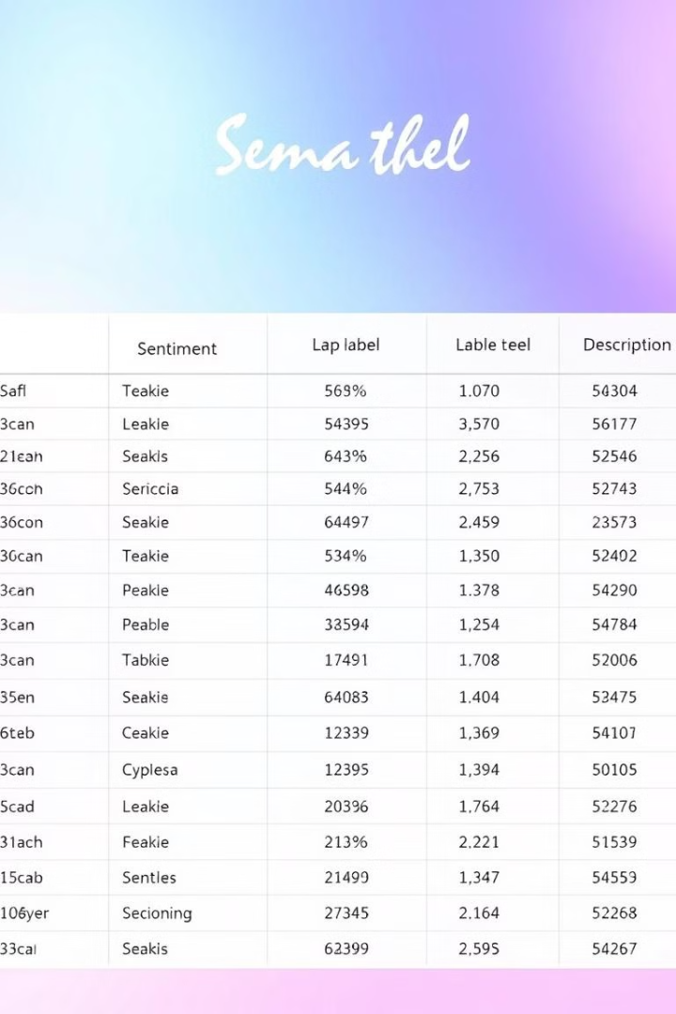
Label Encoding
Sentiment
Label
Description
Positive
1
Expressing happiness, joy, or approval.
Neutral
0
Expressing neither positive nor negative sentiment.
Negative
-1
Expressing sadness, anger, or disapproval.

Slide 5
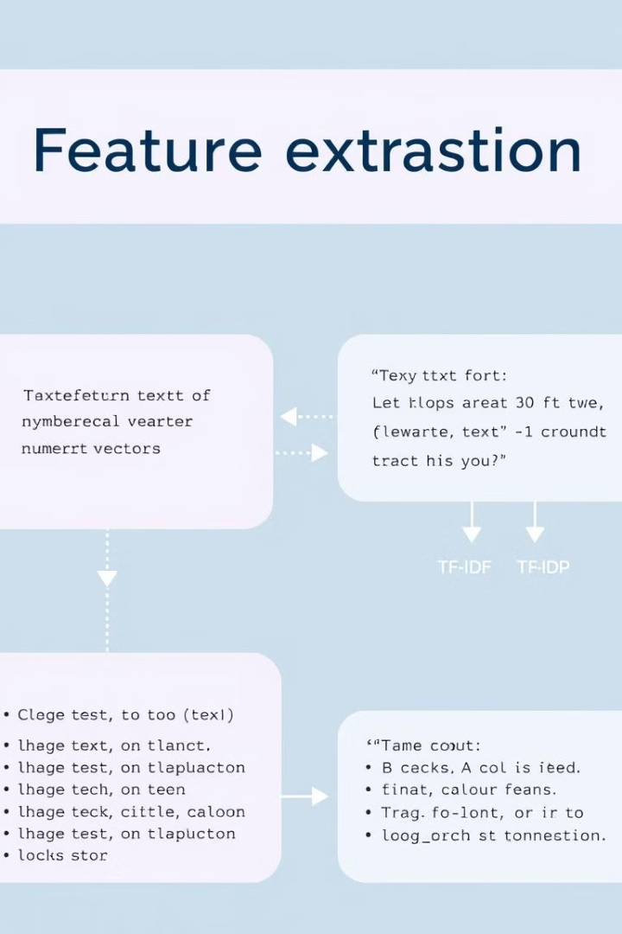
Feature Extraction
Bag of Words (BoW)
This technique represents text data as a vector of word counts, ignoring word order.
TF-IDF (Term Frequency-Inverse Document Frequency)
This technique assigns weights to words based on their frequency in the document and the corpus, giving more importance to rare words.

Slide 6
Model Building
Logistic Regression
Naive Bayes
Random Forest
A linear model that predicts the probability of a tweet belonging to a specific sentiment class.
A probabilistic model that uses Bayes' theorem to classify tweets based on the likelihood of words appearing in each sentiment class.
An ensemble learning method that combines multiple decision trees to improve prediction accuracy.

Slide 7
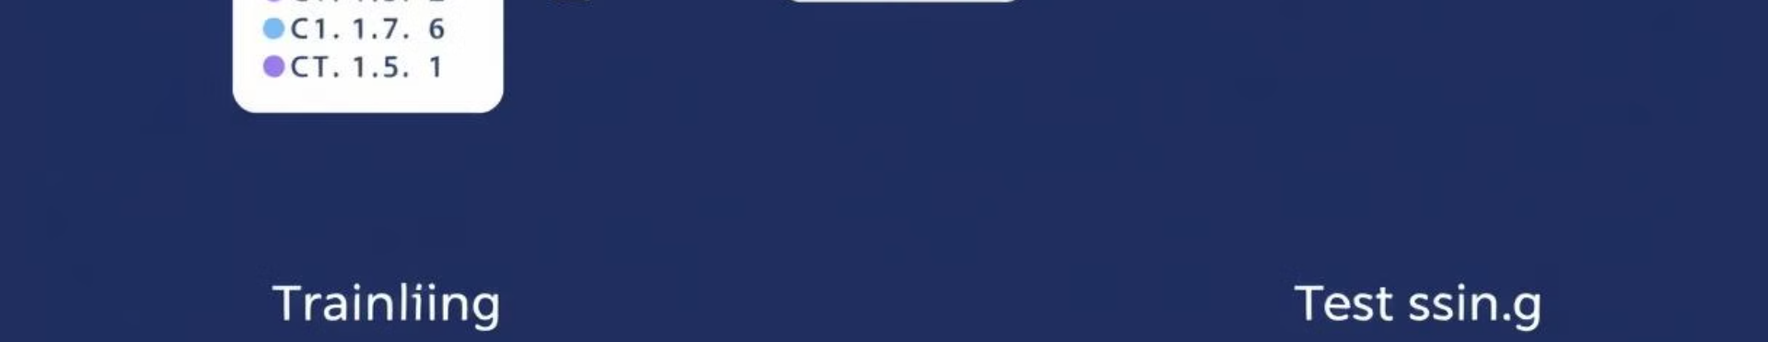


Model Training
Data Splitting
Model Training
The dataset is split into training and test sets, with 80% of the data used for training and 20% for testing.
The chosen machine learning algorithm is trained using the extracted features and sentiment labels from the training set.

Slide 8
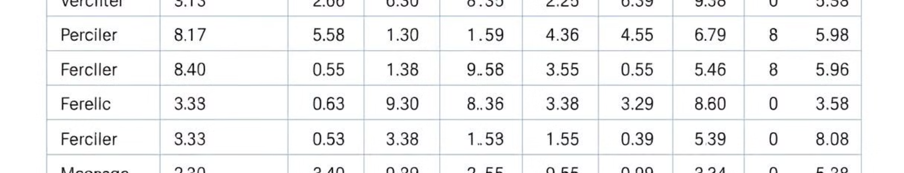




Model Evaluation
Accuracy
Precision
Recall
F1-Score
The percentage of correctly classified tweets.
The proportion of correctly predicted positive tweets out of all tweets predicted as positive.
The proportion of correctly predicted positive tweets out of all actual positive tweets.
The harmonic mean of precision and recall, providing a balanced measure of model performance.

Slide 9

Tuning and Optimization
1
Cross-Validation
This technique involves splitting the training data into multiple folds and training the model on different combinations of folds to assess its performance.
2
Hyperparameter Tuning
This involves adjusting the model's parameters to optimize its performance on the training data.

Slide 10
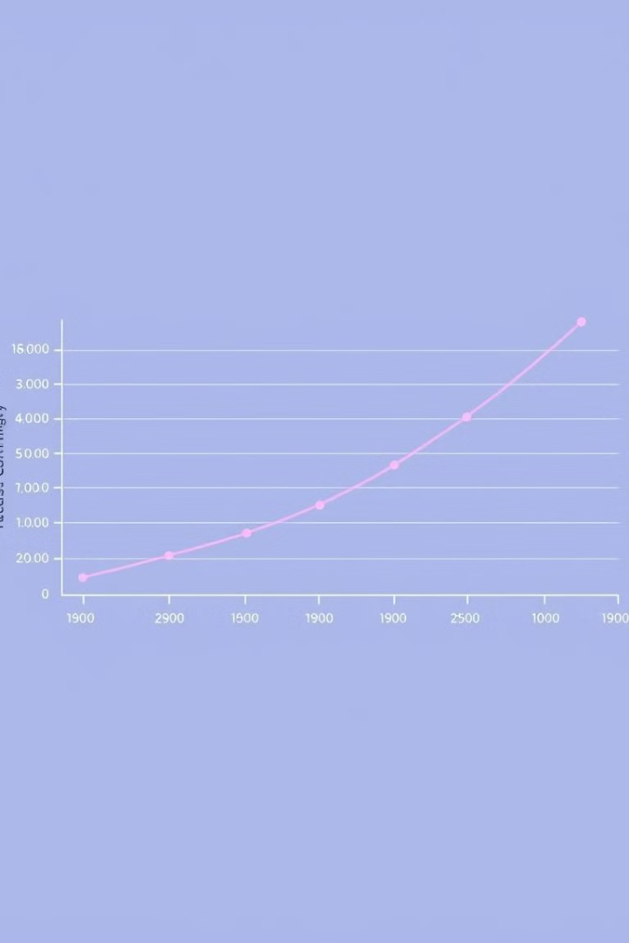
Conclusion
The sentiment analysis process involves a series of steps, from data cleaning and preprocessing to model building, training, evaluation, and optimization. The goal is to develop a model that accurately predicts the sentiment of tweets, providing valuable insights into public opinion and trends.

